Slide 1
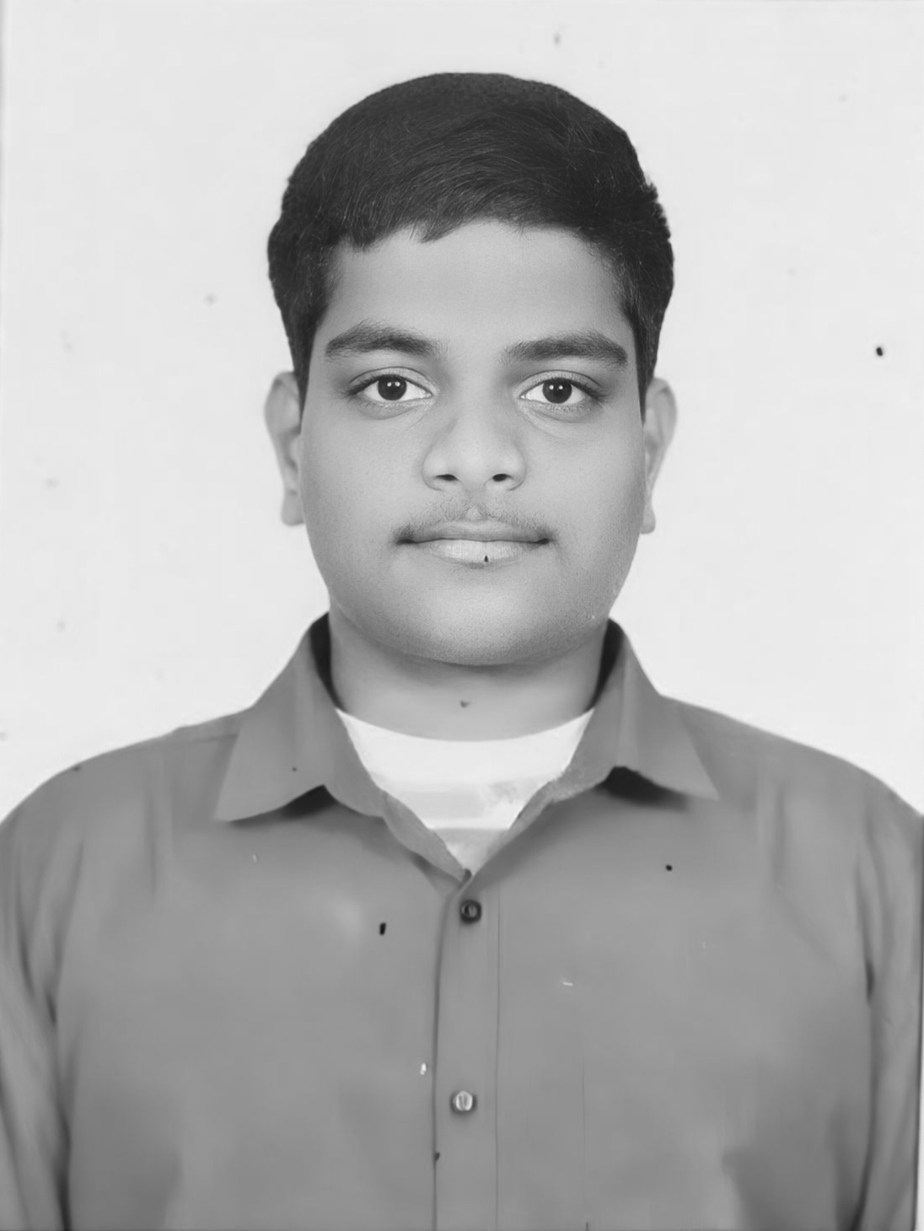
College Enquiry Chatbot
Presented By
Student Name: Pasupuleti maitreya uday durga makhish
College Name: satya institute of technology and management
Department: computer science and engineering
Email ID: pasupuletimaitreya@gmail.com
AICTE Student ID: STU663e3270382e41715352176

Slide 2
Problem Statement
In most educational institutions, students and stakeholders face delays in getting responses to their queries related to admissions, facilities, courses, etc.
Manual query handling is time-consuming, inefficient, and often leads to unsatisfactory experiences.A solution is needed to provide quick, consistent, and accessible information 24/7.

Slide 3
Proposed Solution
The proposed system is a College Enquiry Chatbot that automates query responses using a predefined dataset.
Provides real-time answers to frequently asked questions.
Built using Python and Flask for web-based interaction.
Includes user login, registration, and query interfaces.
Enhances user experience with fast and consistent responses.

Slide 4
System Requirements
Python
Flask Framework
HTML, CSS and BootStrap
Browser UI Access

Slide 5
Library used
Key Components
Flask
Re
Json
os
app.py: Flask server logic
chatbot.py: Logic to process queries
Dataset.txt: Source of question-answer pairs
HTML templates: User interface screens

Slide 6
Algorithm
Algorithm & Deployment
Deployment
Uses keyword and pattern matching with regular expressions.
Searches Dataset.txt for relevant responses.
Prioritizes closest match using rule-based logic.
Flask server runs locally or can be deployed to platforms like Heroku or PythonAnywhere.
Web interface created with HTML and Bootstrap.
All components integrated under a single project directory.

Slide 7
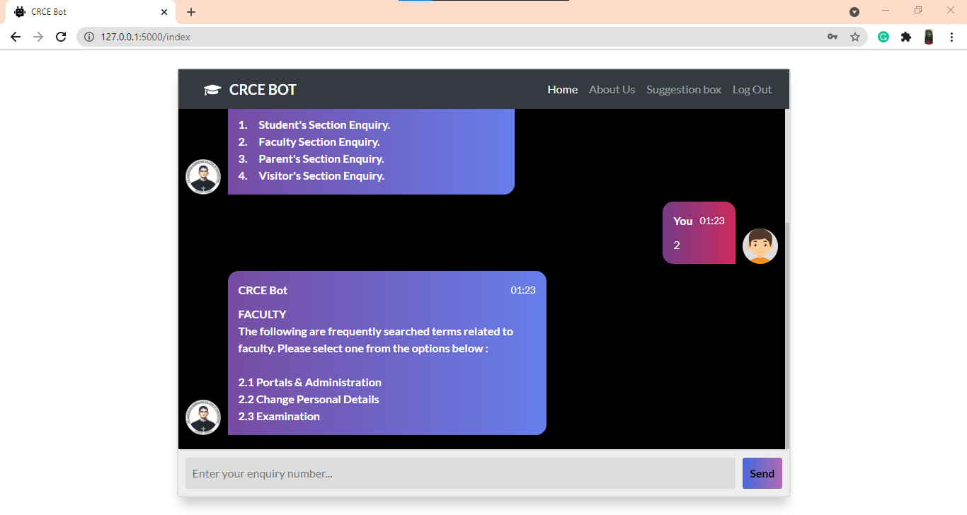
Result
Instant query responses for admission, placements, campus, etc.
Functional login/register system
Clean and simple user interface

Slide 8
Conclusion
The chatbot successfully automates routine college enquiries and reduces workload for administrative staff.
It enhances accessibility and reliability of information delivery.
Easy to maintain and update as college details evolve.

Slide 9
Future Scope
Integrate NLP models (e.g., spaCy, GPT) for better understanding of queries.
Add voice input/output capability.
Sync with live database or ERP for dynamic information.
Support multiple languages for wider usability.

Slide 10
References
Flask Documentation – https://flask.palletsprojects.com/
Python Official Documentation – https://docs.python.org/3/Bootstrap Framework – https://getbootstrap.com/
Stack Overflow – https://stackoverflow.com/ (for resolving minor integration issues)
GeeksforGeeks Python Tutorials – https://www.geeksforgeeks.org/python-programming-language/
W3Schools HTML/CSS Reference – https://www.w3schools.com/
OpenAI GPT Overview (for chatbot concept inspiration) – https://platform.openai.com/docs/
GitHub Project Link – https://github.com/Maitreya2004/EDUNET-Microsoft-AI-Azure-Project.git

